Slide 1

CS101 Data Structures
AVL Trees
Notes:
Adapted from the slides by Douglas Wilhelm Harder of U Waterloo (https://ece.uwaterloo.ca/~dwharder/aads/Lecture_materials/)
May also contain material from the slides at https://courses.cs.washington.edu/courses/cse326/03wi/326lecturesb.shtml (by Dan Suciu of U Washington)

Slide 2
Outline
Define height balancing
Maintaining balance within a tree
AVL trees
Difference of heights
Maintaining balance after insertions and erases
Can we store AVL trees as arrays?

Slide 3
Background
From previous lectures:
Binary search trees store linearly ordered data
Best case height: Θ(ln(n))
Worst case height: O(n)
Requirement:
Define and maintain balance to ensure Θ(ln(n)) height

Slide 4
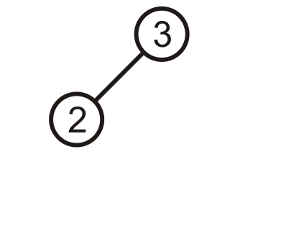
Prototypical Examples
These two examples demonstrate how we can correct for imbalances: starting with this tree, add 1:

Slide 5
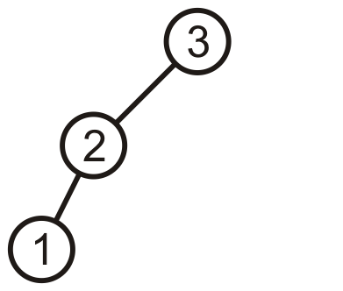
Prototypical Examples
This is more like a linked list; however, we can fix this…

Slide 6
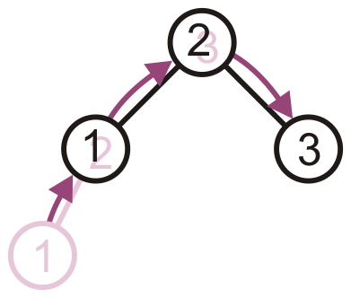
Prototypical Examples
Promote 2 to the root, demote 3 to be 2’s right child, and 1 remains the left child of 2

Slide 7
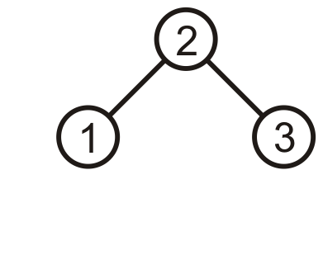
Prototypical Examples
The result is a perfect, though trivial tree

Slide 8
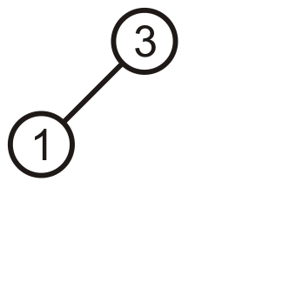
Prototypical Examples
Alternatively, given this tree, insert 2

Slide 9
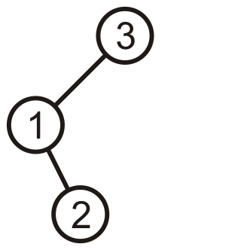
Prototypical Examples
Again, the product is a linked list; however, we can fix this, too

Slide 10
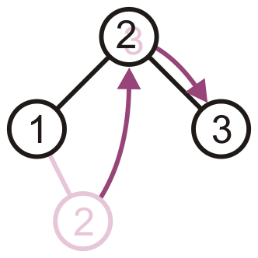
Prototypical Examples
Promote 2 to the root, and assign 1 and 3 to be its children

Slide 11
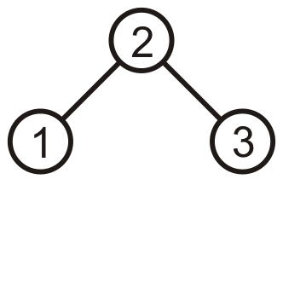
Prototypical Examples
The result is, again, a perfect tree
These examples may seem trivial, but they are the basis for the corrections in the next data structure we will see: AVL trees

Slide 12
AVL Trees
Named after Adelson-Velskii and Landis
A binary search tree is said to be AVL balanced if:
The difference in the heights between the left and right sub-trees is at most 1, and
Both sub-trees are themselves AVL trees
Recall:
An empty tree has height –1
A tree with a single node has height 0

Slide 13
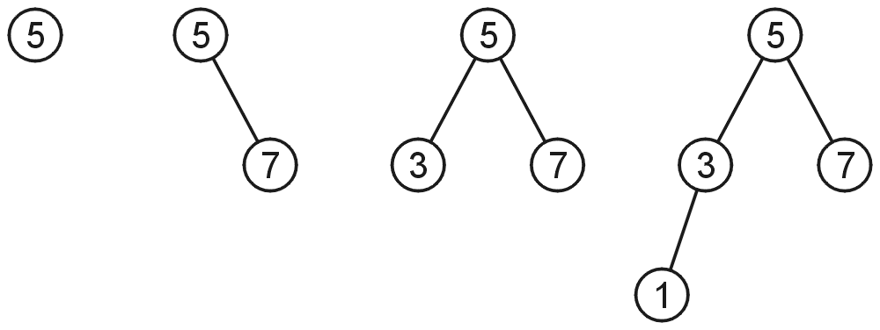
AVL Trees
AVL trees with 1, 2, 3, and 4 nodes:

Slide 14
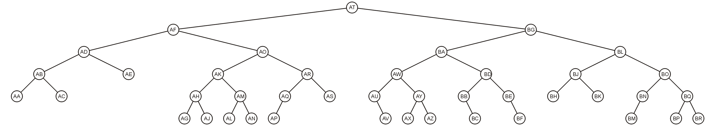
AVL Trees
Here is a larger AVL tree (42 nodes):

Slide 15
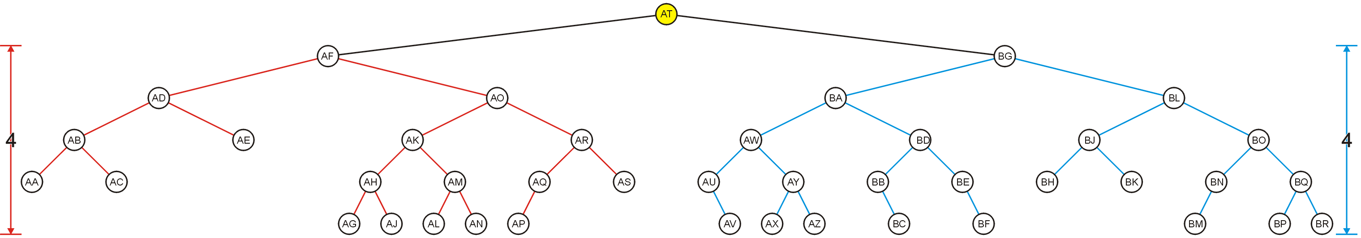
AVL Trees
The root node is AVL-balanced:
Both sub-trees are of height 4:

Slide 16
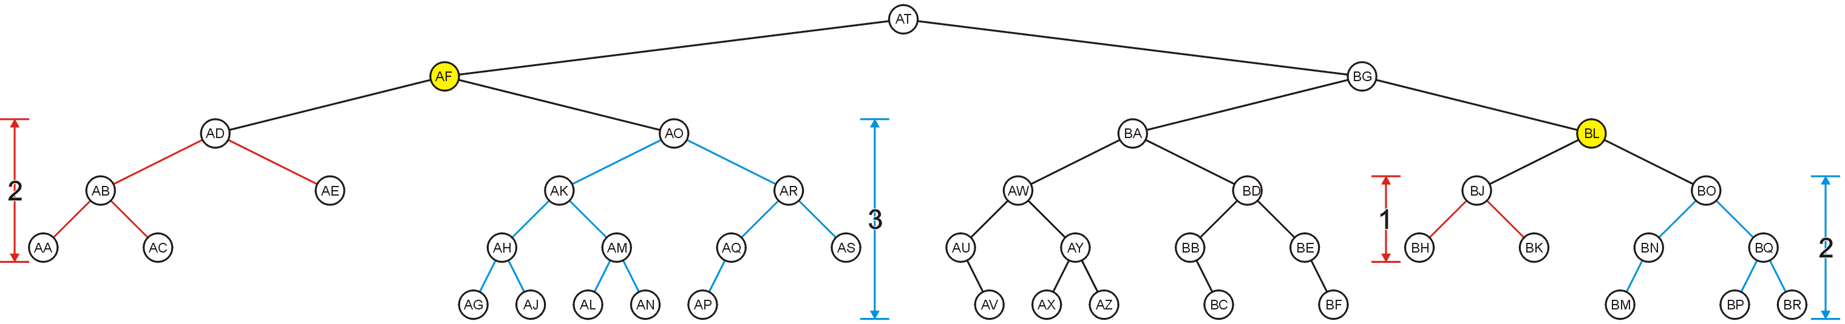
AVL Trees
All other nodes (e.g., AF and BL) are AVL balanced
The sub-trees differ in height by at most one

Slide 17
Height of an AVL Tree
By the definition of complete trees, any complete binary search tree is an AVL tree
Thus, the upper bound on the number of nodes in an AVL tree of height h is a perfect binary tree with 2^{h + 1} – 1 nodes
What is the lower bound?

Slide 18

Height of an AVL Tree
Let F(h) be the fewest number of nodes in a tree of height h
From a previous slide:
F(0) = 1
F(1) = 2
F(2) = 4
Can we find F(h)?

Slide 19
Height of an AVL Tree
The worst-case AVL tree of height h would have:
A worst-case AVL tree of height h – 1 on one side,
A worst-case AVL tree of height h – 2 on the other, and
The root node
We get: F(h) = F(h – 1) + 1 + F(h – 2)

Slide 20
Height of an AVL Tree
This is a recurrence relation:
The solution?
Note that F(h) + 1 = (F(h – 1) + 1) + (F(h – 2) + 1)
Therefore, F(h) + 1 is a Fibonacci number:
F(0) + 1 = 2 → F(0) = 1
F(1) + 1 = 3 → F(1) = 2
F(2) + 1 = 5 → F(2) = 4
F(3) + 1 = 8 → F(3) = 7
F(4) + 1 = 13 → F(4) = 12
F(5) + 1 = 21 → F(5) = 20
F(6) + 1 = 34 → F(6) = 33

Slide 21
Height of an AVL Tree
Alternatively, if it wasn’t so simple:
> rsolve( {F(0) = 1, F(1) = 2,
F(h) = 1 + F(h - 1) + F(h - 2)}, F(h) );
> asympt( %, h );

Slide 22
Height of an AVL Tree
This is approximately
F(h) ≈ 1.8944 φ ^{h} – 1
where φ ≈ 1.6180 is the golden ratio
That is, F(h) = Θ(φ ^{h})
Thus, we may find the maximum value of h for a given n:
Notes:
In actuality, the floor on the log function causes some fluctuation, but 44 % is quite reasonable…
Recall that the height of a complete tree is h = ⌊lg(n)⌋
The floor function makes the analysis interesting
With n = 3 nodes, it can be twice the height
For n ≥ 4096, 45% worse is an upper bound

Slide 23
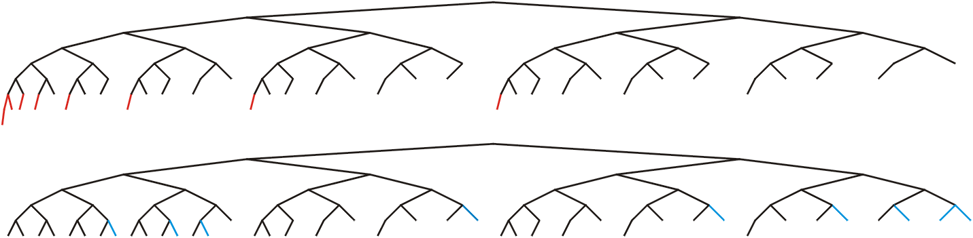
Height of an AVL Tree
In this example, n = 88, the worst- and best-case scenarios differ in height by only 2

Slide 24
Height of an AVL Tree
If n = 10⁶, the bounds on h are:
The minimum height: log₂( 10⁶ ) – 1 ≈ 19
The maximum height: log_{φ}( 10⁶ / 1.8944 ) < 28

Slide 25
Maintaining Balance
Observe that:
Inserting a node can increase the height of a tree by at most 1
Removing a node can decrease the height of a tree by at most 1
This may cause some nodes to be unbalanced. We may need to rebalance the tree after insertion or removal.

Slide 26
Maintaining Balance
To calculate changes in height, the member function height() must run in Θ(1) time
Our implementation of height is Θ(n)
Introduce a member variable：
int tree_height;
This variable is updated during inserting and erasing

Slide 27
Maintaining Balance
Only insert and erase may change the height
This is the only place we need to update the height
These algorithms are already recursive

Slide 28
Insert
template <typename Type>
bool AVL_node<Type>::insert( const Type & obj, AVL_node<Type> *&ptr_to_this ) {
if ( empty() ) {
ptr_to_this = new AVL_node( obj );
return true;
} else if ( obj < element ) {
if ( left()->insert( obj, left_tree ) ) {
tree_height = max( height(), 1 + left()->height() );
return true;
} else {
return false;
}
} else if ( obj > element ) {
// ...
} else {
return false;
}
}

Slide 29
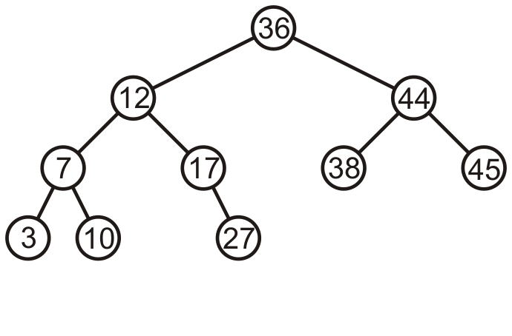
Maintaining Balance
Consider this AVL tree

Slide 30
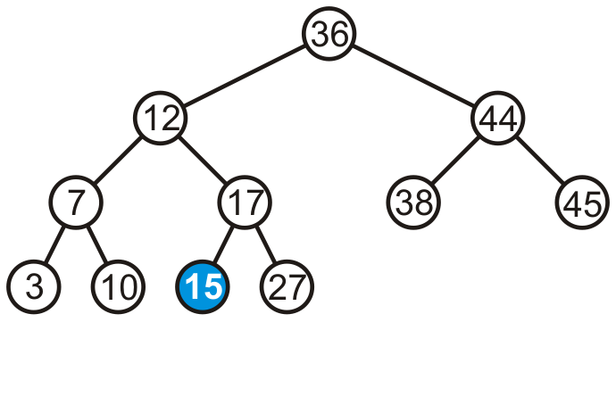
Maintaining Balance
Consider inserting 15 into this tree
In this case, none of the heights of the trees change

Slide 31
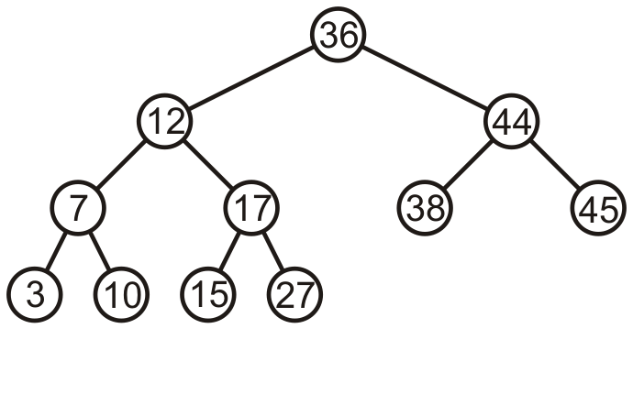
Maintaining Balance
The tree remains balanced

Slide 32
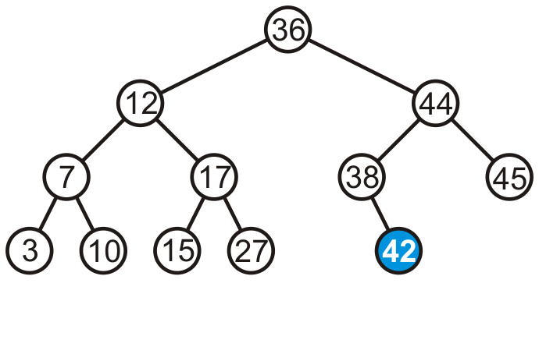
Maintaining Balance
Consider inserting 42 into this tree

Slide 33
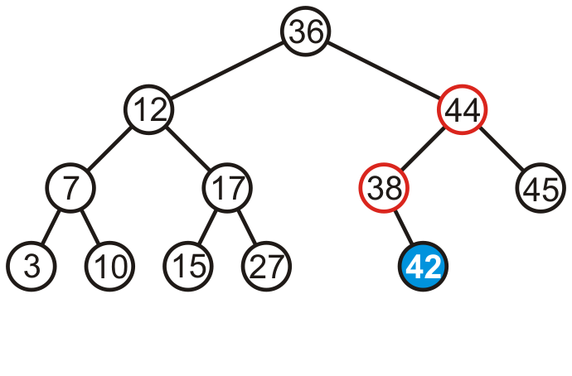
Maintaining Balance
Consider inserting 42 into this tree
Now we see the heights of two sub-trees have increased by one
The tree is still balanced

Slide 34
Maintaining Balance
If a tree is AVL balanced, for an insertion to cause an imbalance:
The heights of the sub-trees must differ by 1
The insertion must increase the height of the deeper sub-tree by 1

Slide 35
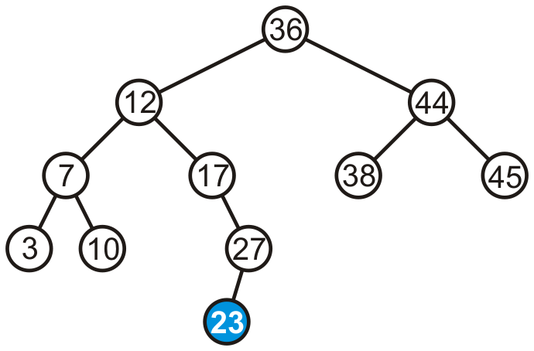
Maintaining Balance
Suppose we insert 23 into our initial tree

Slide 36
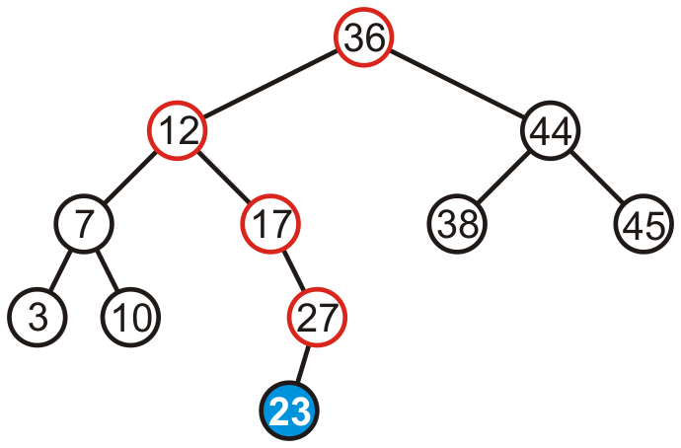
Maintaining Balance
The heights of each of the sub-trees from here to the root are increased by one

Slide 37
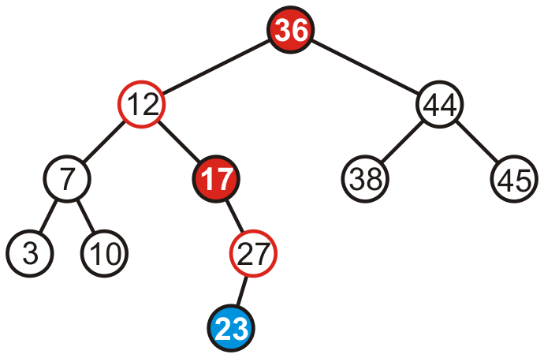
Maintaining Balance
However, only two of the nodes are unbalanced: 17 and 36

Slide 38
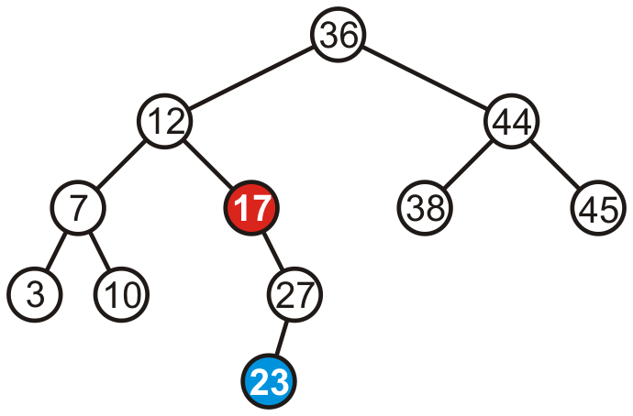
Maintaining Balance
However, only two of the nodes are unbalanced: 17 and 36

Slide 39
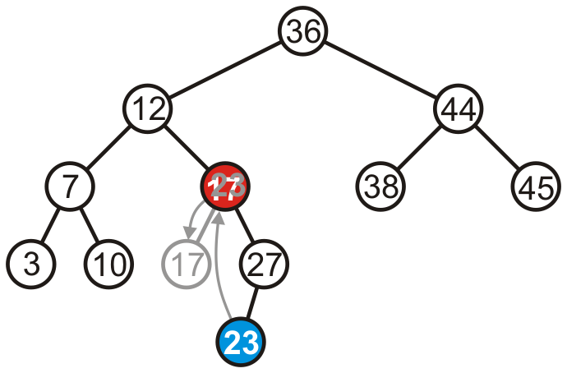
Maintaining Balance
We can promote 23 to where 17 is, and make 17 the left child of 23

Slide 40
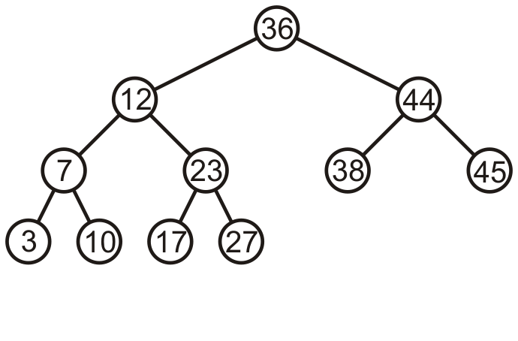
Maintaining Balance
Thus, that node is no longer unbalanced
Incidentally, the root is now also balanced!

Slide 41
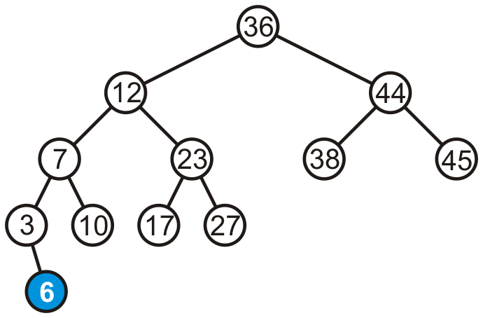
Maintaining Balance
Consider adding 6:

Slide 42
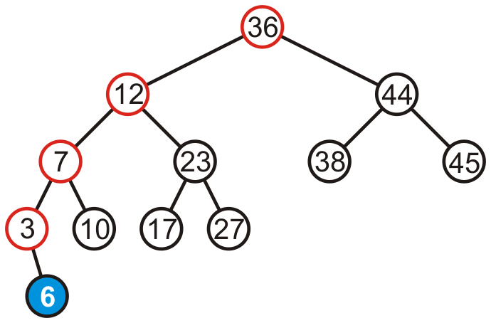
Maintaining Balance
The height of each of the trees in the path back to the root are increased by one

Slide 43
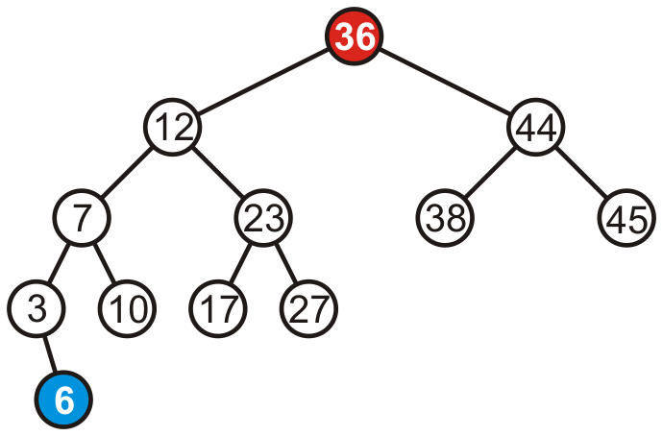
Maintaining Balance
The height of each of the trees in the path back to the root are increased by one
However, only the root node is now unbalanced

Slide 44
Maintaining Balance
To fix this, we will look at the general case…

Slide 45
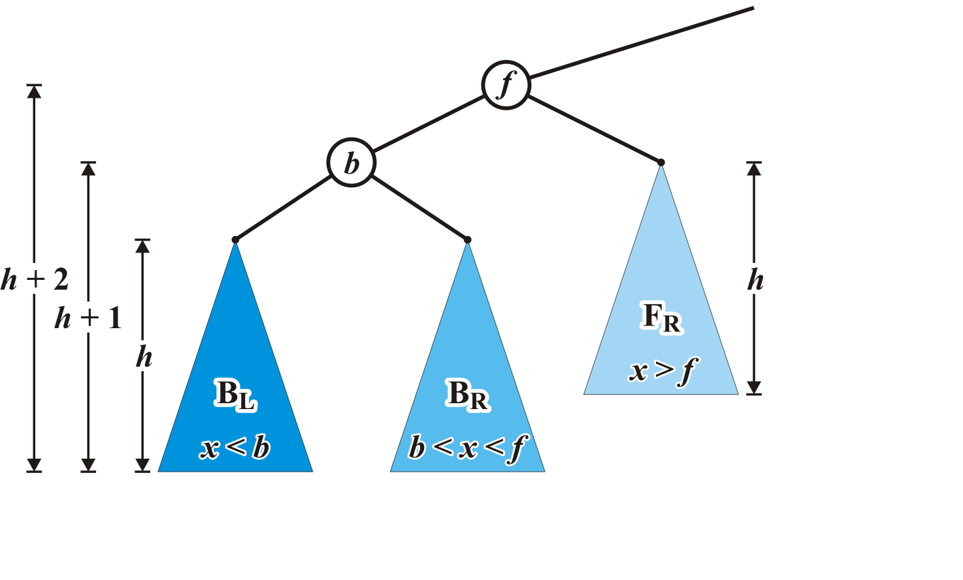
Maintaining Balance: Case 1
Consider the following setup
Each blue triangle represents a tree of height h

Slide 46
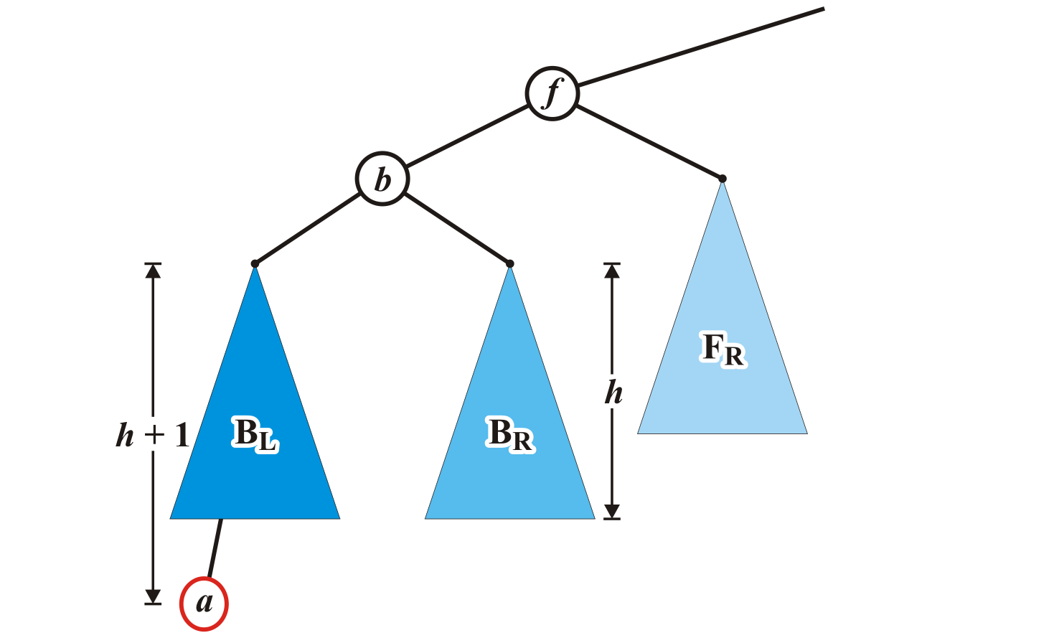
Maintaining Balance: Case 1
Insert a into this tree: it falls into the left subtree B_{L} of b
Assume B_{L} remains balanced
The tree rooted at b is also balanced
left-left

Slide 47
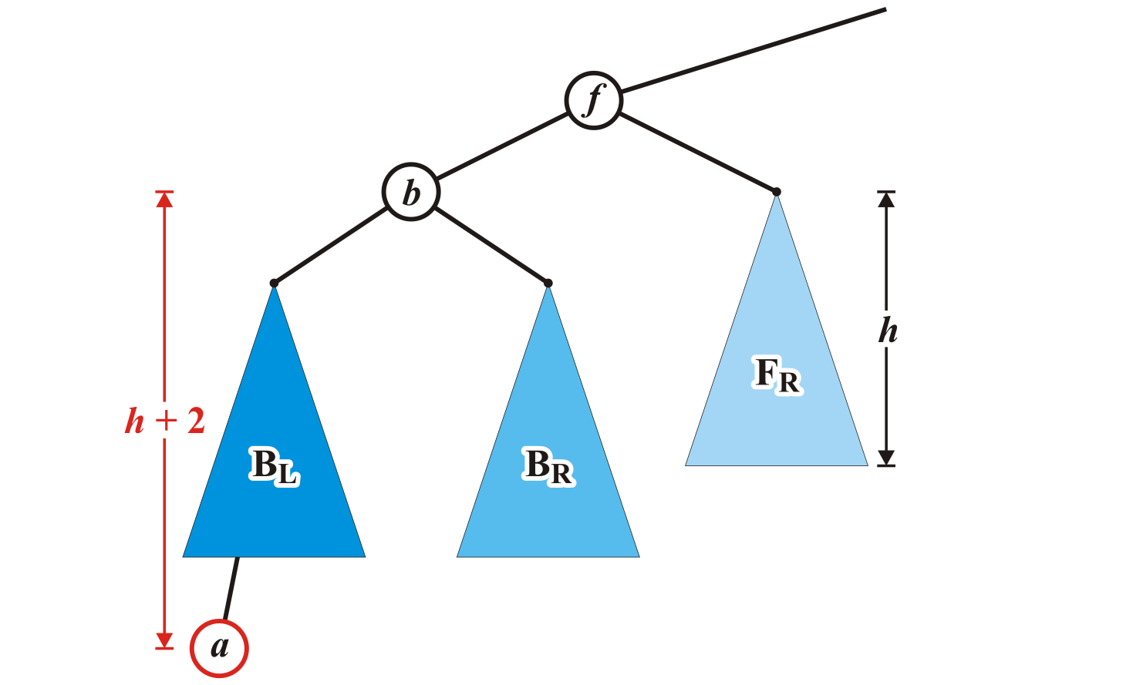
Maintaining Balance: Case 1
The tree rooted at node f is now unbalanced
We will correct the imbalance at this node

Slide 48
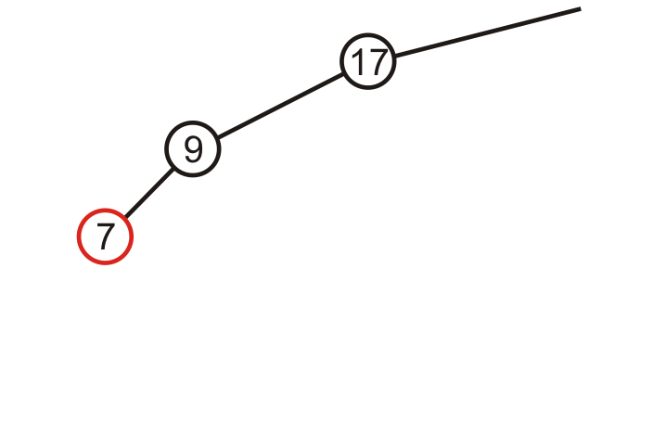
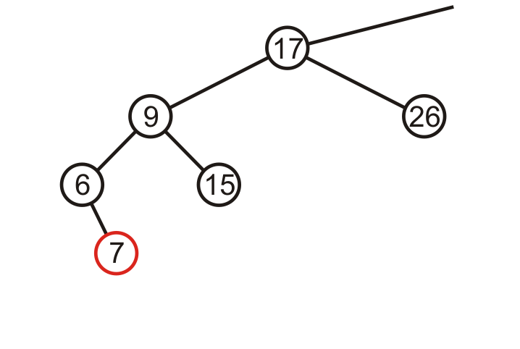

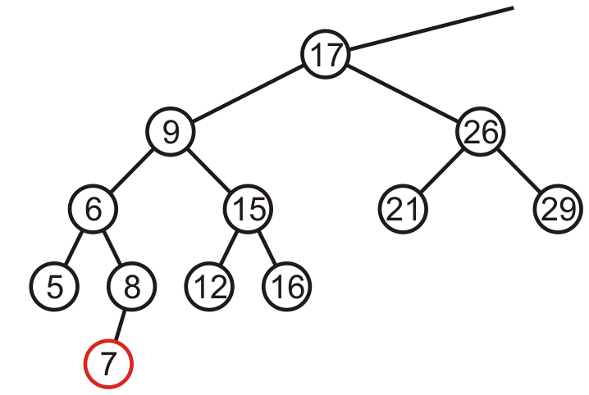
Maintaining Balance: Case 1
Here are examples of when the insertion of 7 may cause this situation when h = –1, 0, and 1

Slide 49
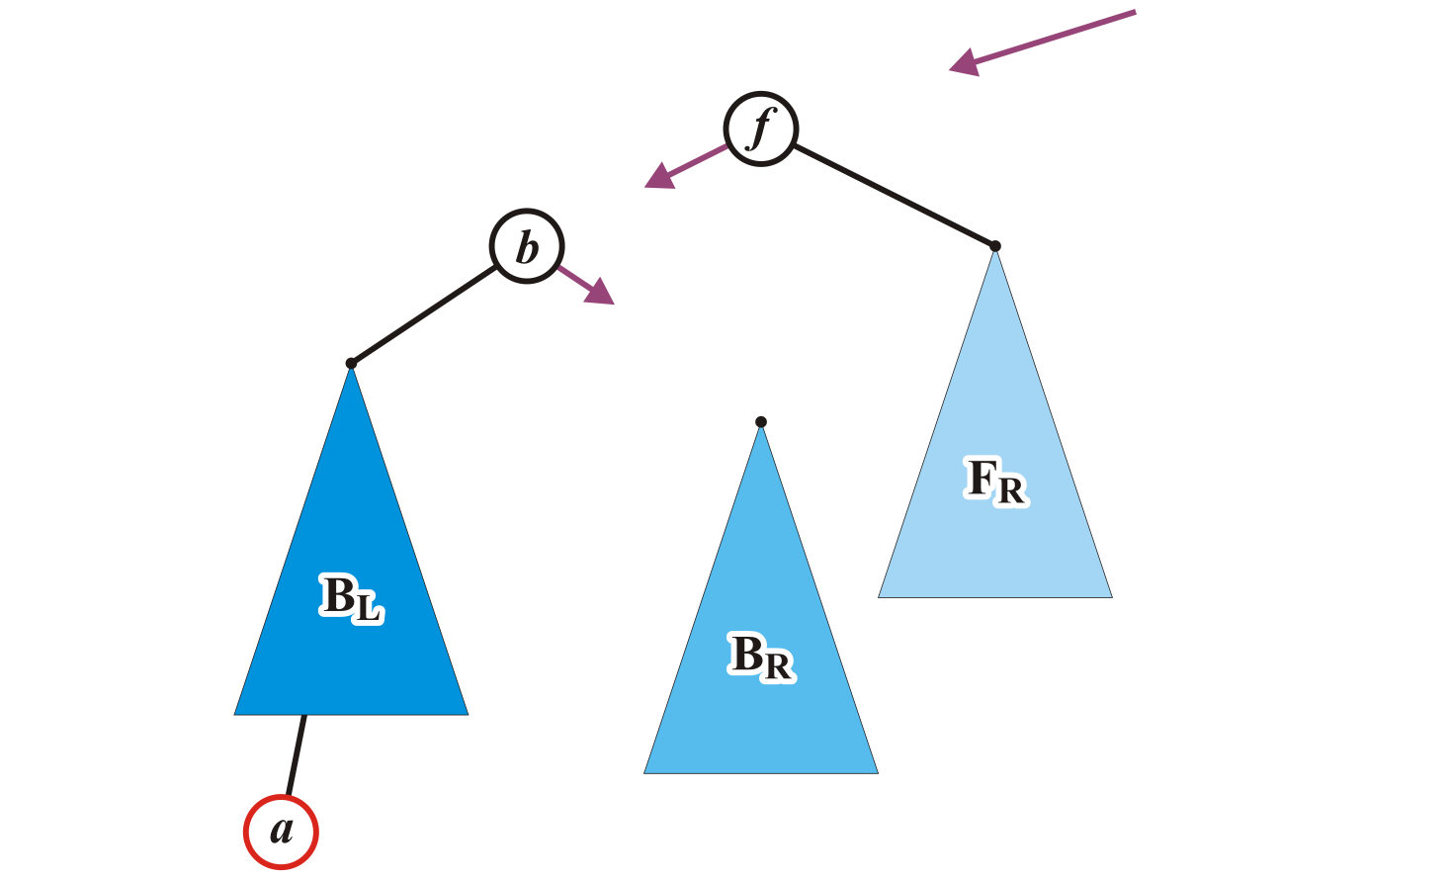
Maintaining Balance: Case 1
We will modify these three pointers
At this point, this references the unbalanced root node f
AVL_node<Type> *b = left(),
*BR = b->right();

Slide 50
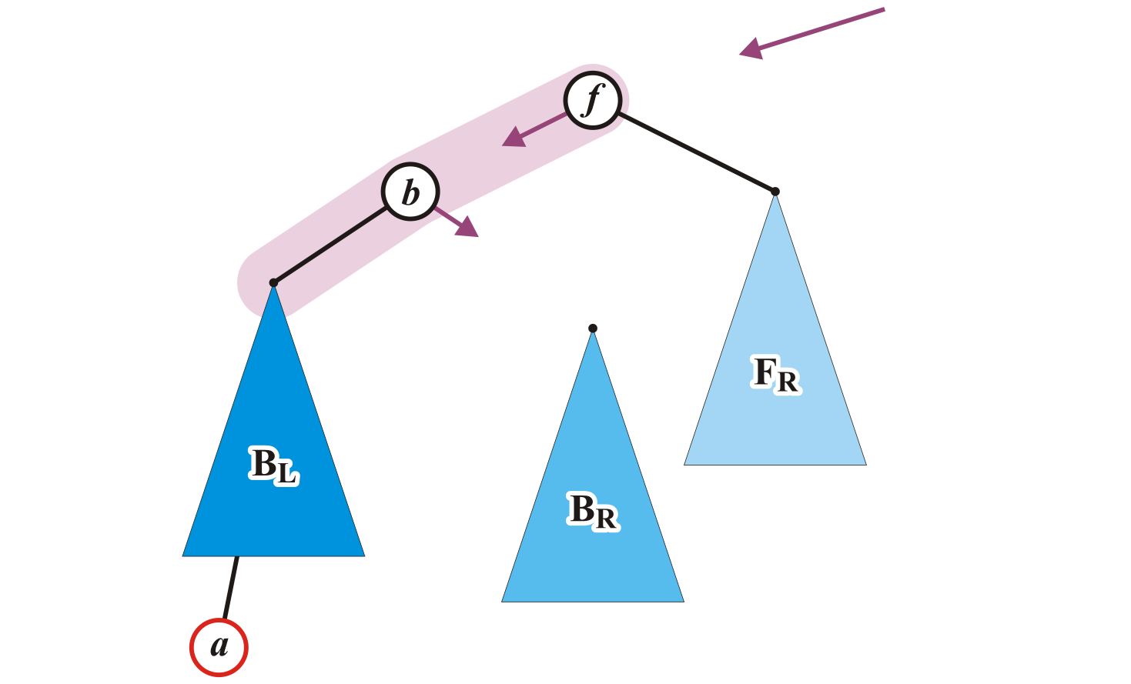
Maintaining Balance: Case 1
Specifically, we will rotate these two nodes around the root:
Recall the first prototypical example
Promote node b to the root and demote node f to be the right child of b
AVL_node<Type> *b = left(),
*BR = b->right();

Slide 51
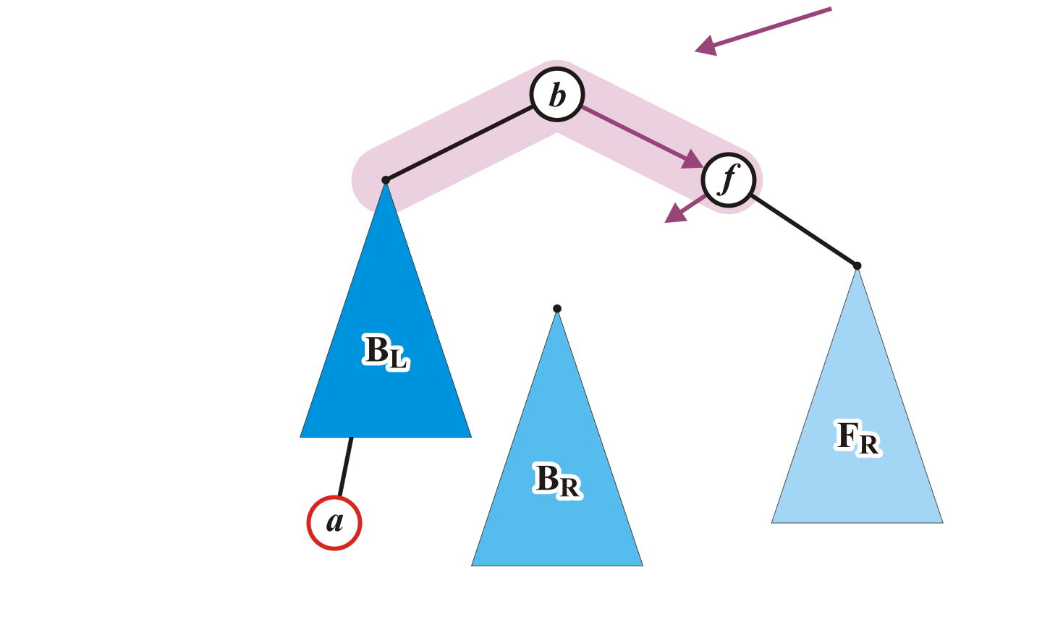
Maintaining Balance: Case 1
This requires the address of node f to be assigned to the right_tree member variable of node b
AVL_node<Type> *b = left(),
*BR = b->right();
b->right_tree = this;

Slide 52
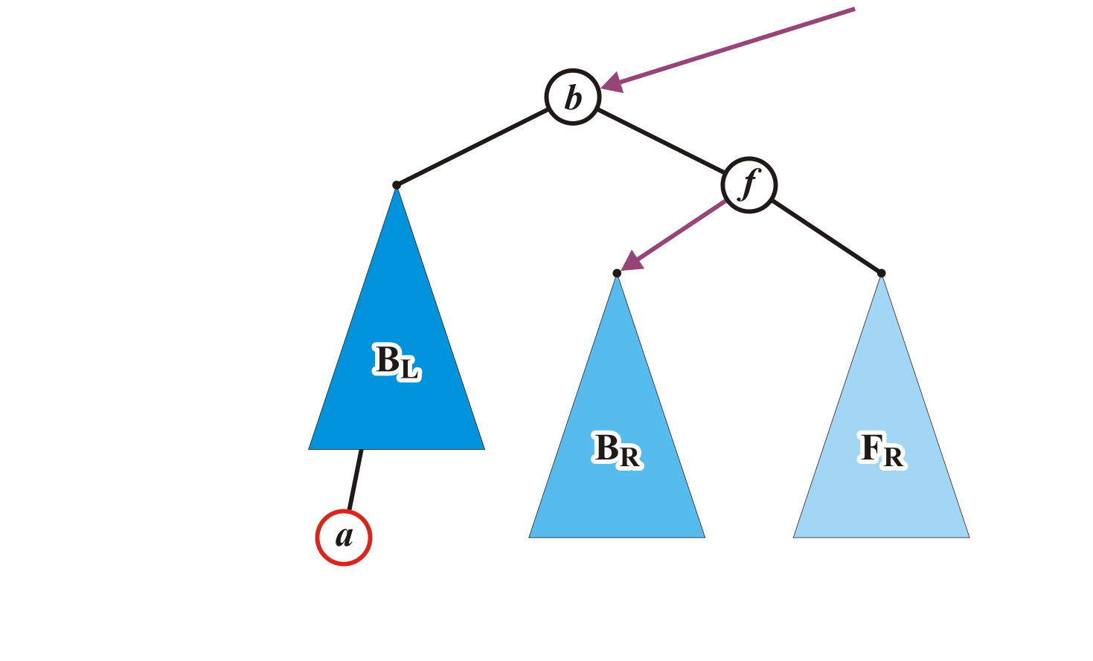
Maintaining Balance: Case 1
Assign any former parent of node f to the address of node b
Assign the address of the tree B_{R} to left_tree of node f
ptr_to_this = b;
left_tree = BR;
AVL_node<Type> *b = left(),
*BR = b->right();
b->right_tree = this;

Slide 53
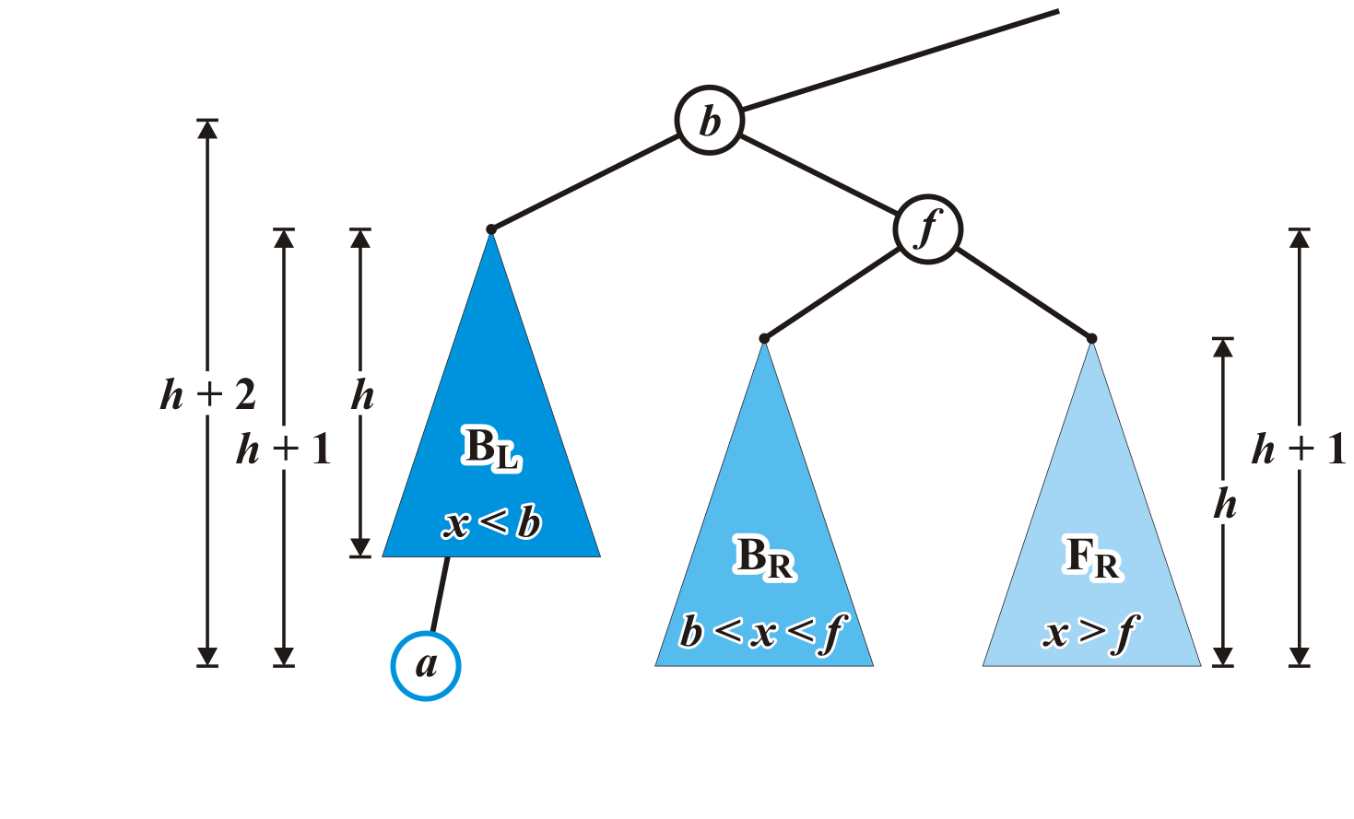
Maintaining Balance: Case 1
The nodes b and f are now balanced, and all remaining nodes of the subtrees are in their correct positions

Slide 54
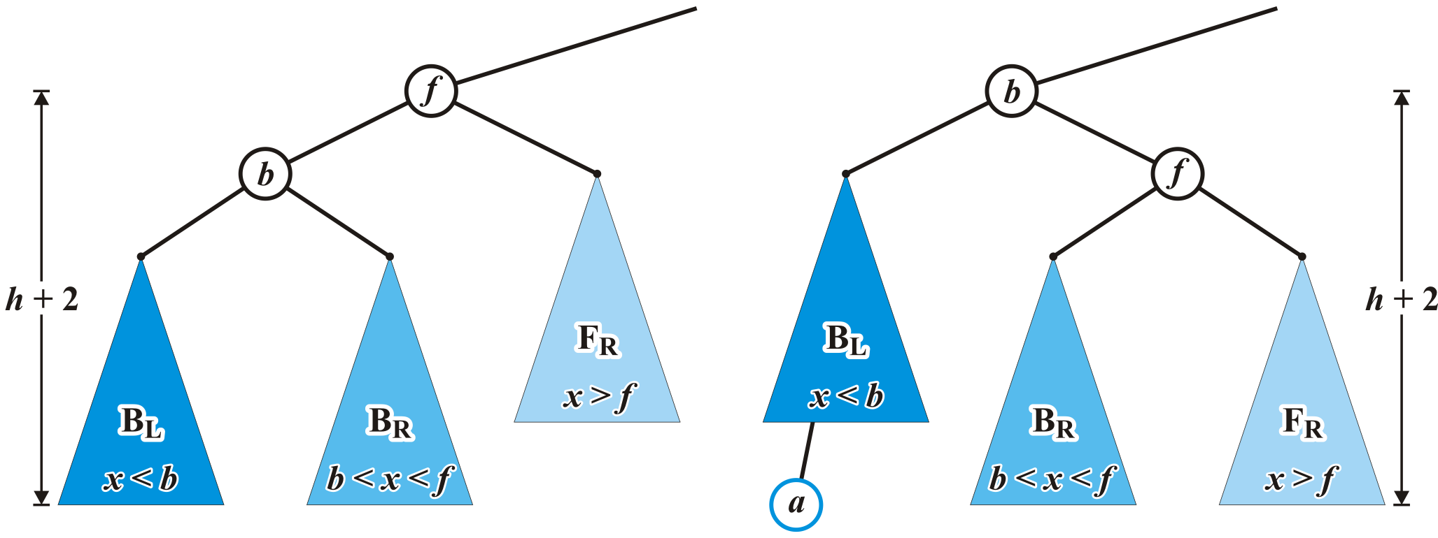
Maintaining Balance: Case 1
Q: will this insertion affect the balance of any ancestors all the way back to the root?
No, because height of the tree rooted at b equals the original height of the tree rooted at f

Slide 55
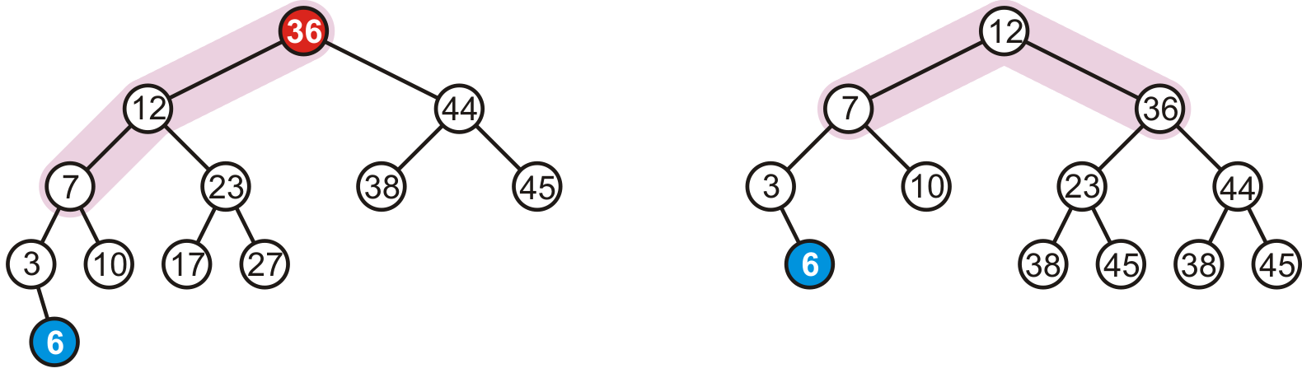
Maintaining Balance: Case 1
In our example case, the correction

Slide 56
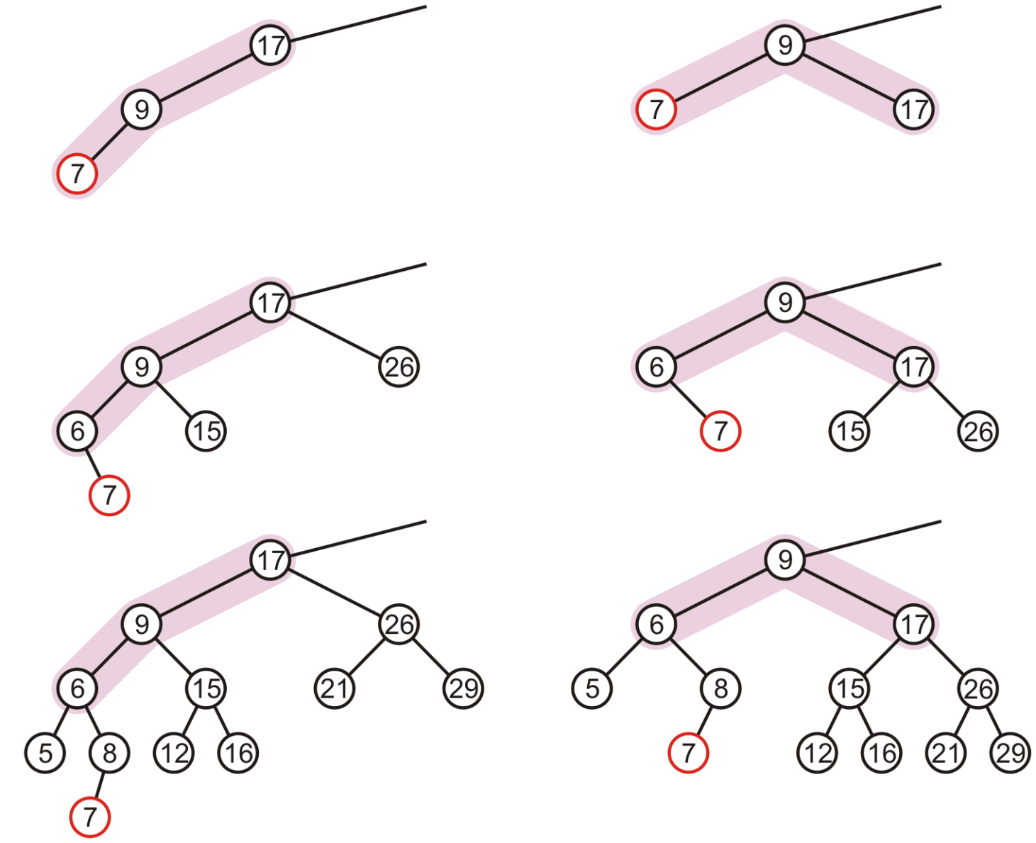
Maintaining Balance: Case 1
In our three sample cases with h = –1, 0, and 1, the node is now balanced and the same height as the tree before the insertion

Slide 57
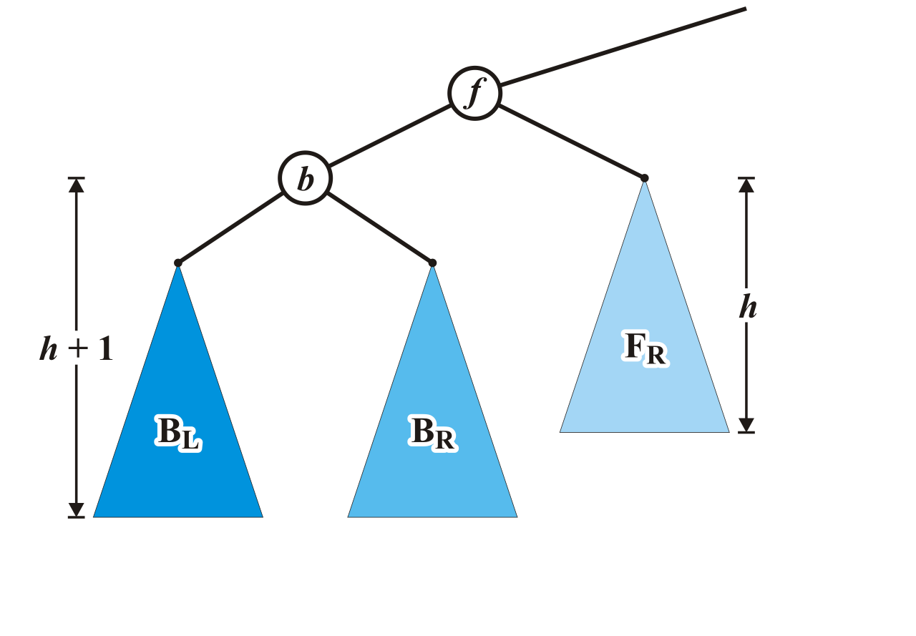
Maintaining Balance: Case 2
Alternatively, consider the insertion of c where b < c < f into our original tree

Slide 58
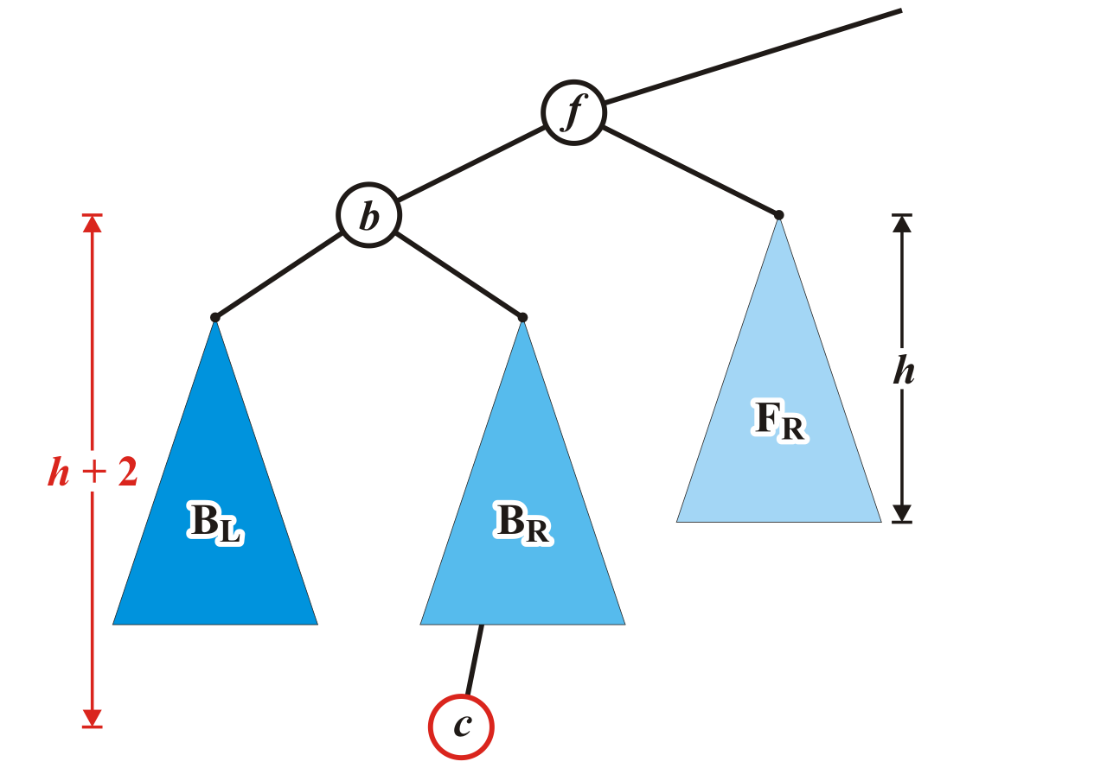
Maintaining Balance: Case 2
Assume that the insertion of c increases the height of B_{R}
Once again, f becomes unbalanced
left-right

Slide 59
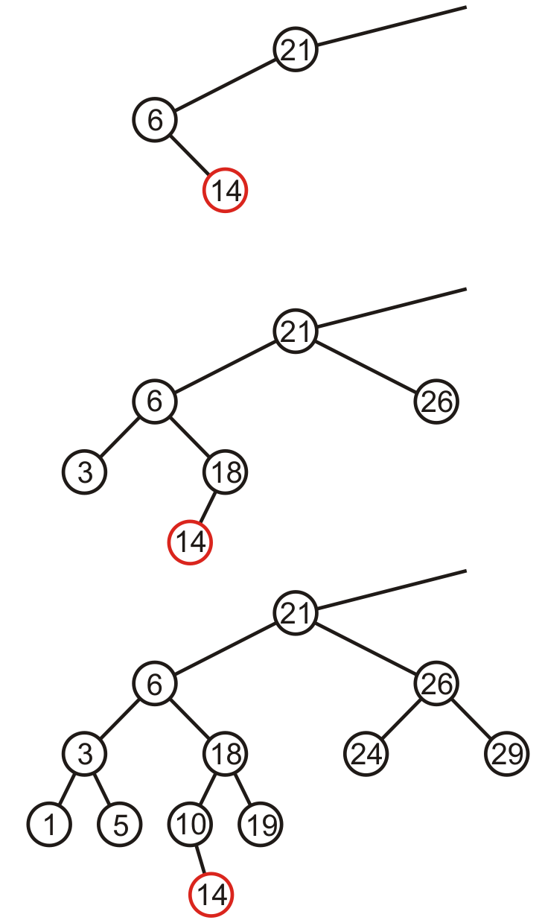
Maintaining Balance: Case 2
Here are examples of when the insertion of 14 may cause this situation when h = –1, 0, and 1

Slide 60
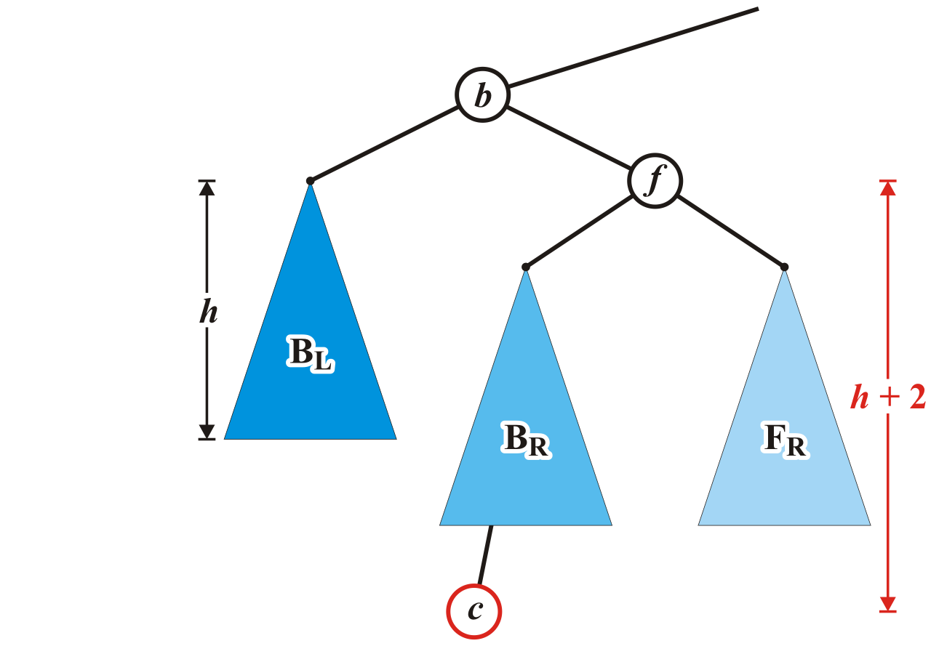
Maintaining Balance: Case 2
Unfortunately, the previous correction does not fix the imbalance at the root of this sub-tree: the new root, b, remains unbalanced

Slide 61
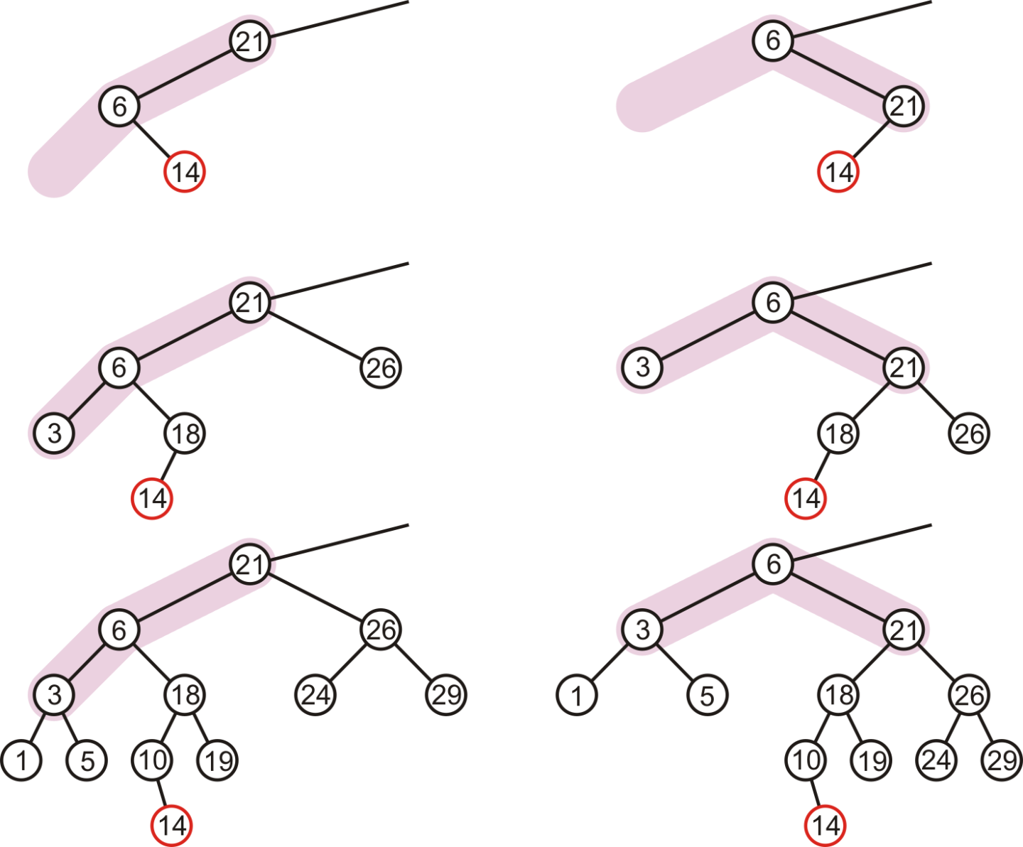
Maintaining Balance: Case 2
In our three sample cases with h = –1, 0, and 1, doing the same thing as before results in a tree that is still unbalanced…
The imbalance is just shifted to the other side

Slide 62
Maintaining Balance: Case 2
We need to look into B_{R}

Slide 63
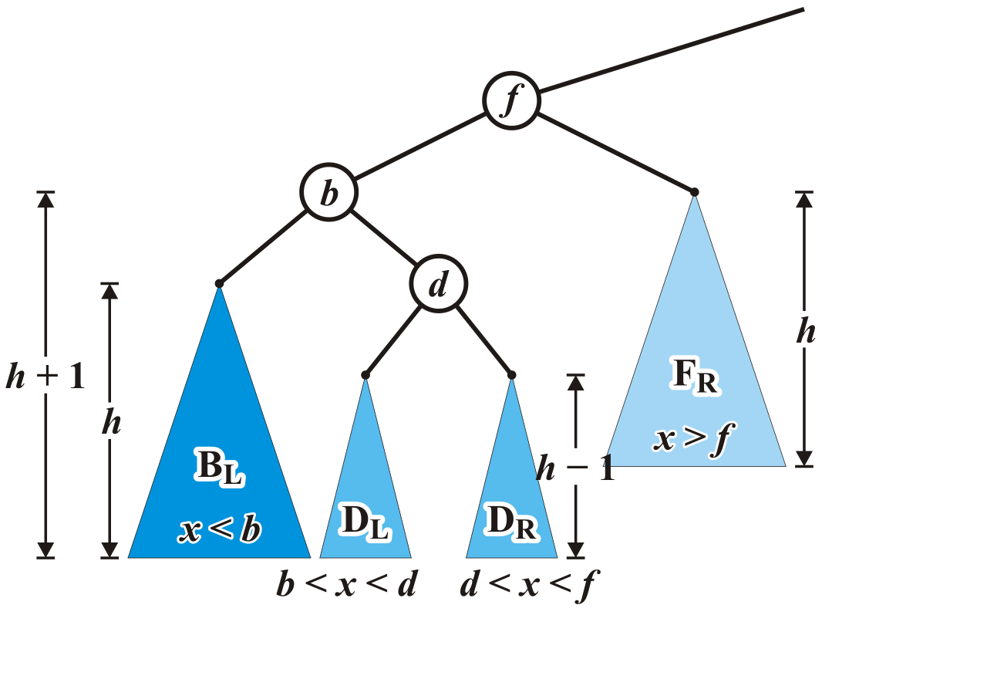
Maintaining Balance: Case 2
Re-label B_{R} as a tree rooted at d with two subtrees of height h – 1

Slide 64
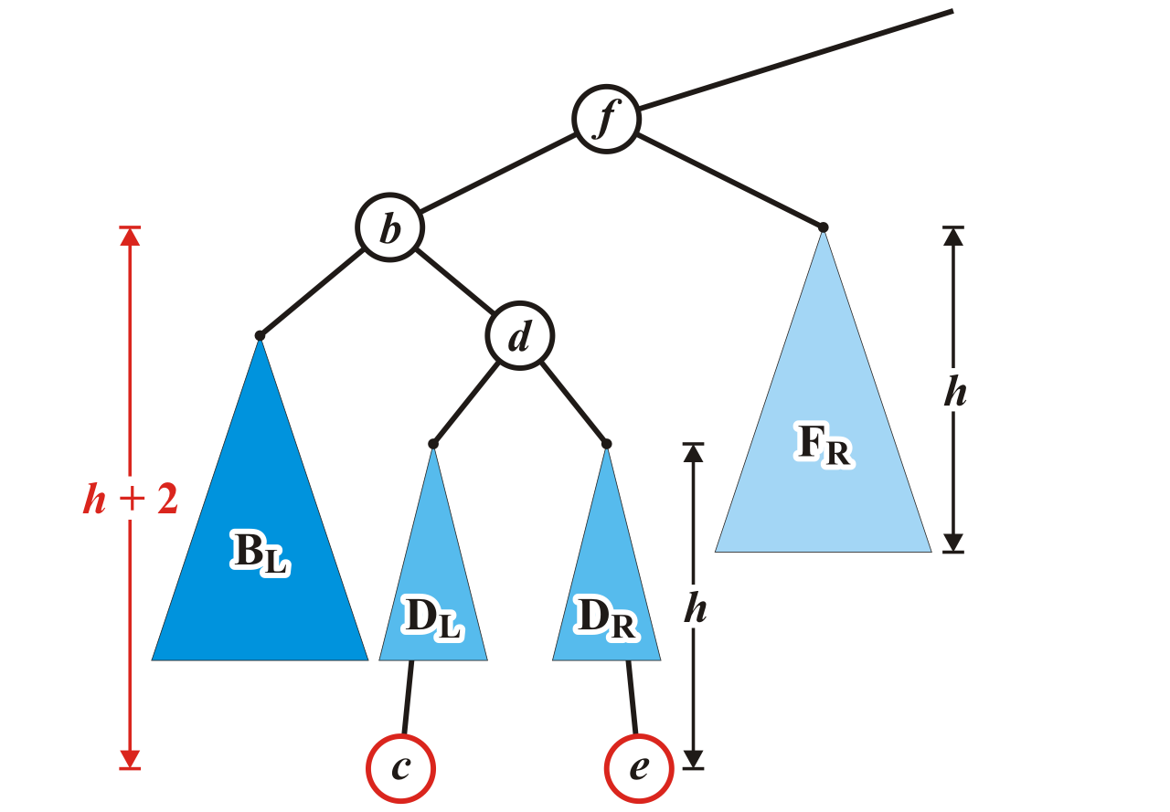
Maintaining Balance: Case 2
Now an insertion causes an imbalance at f
The addition of either c or e will cause this

Slide 65
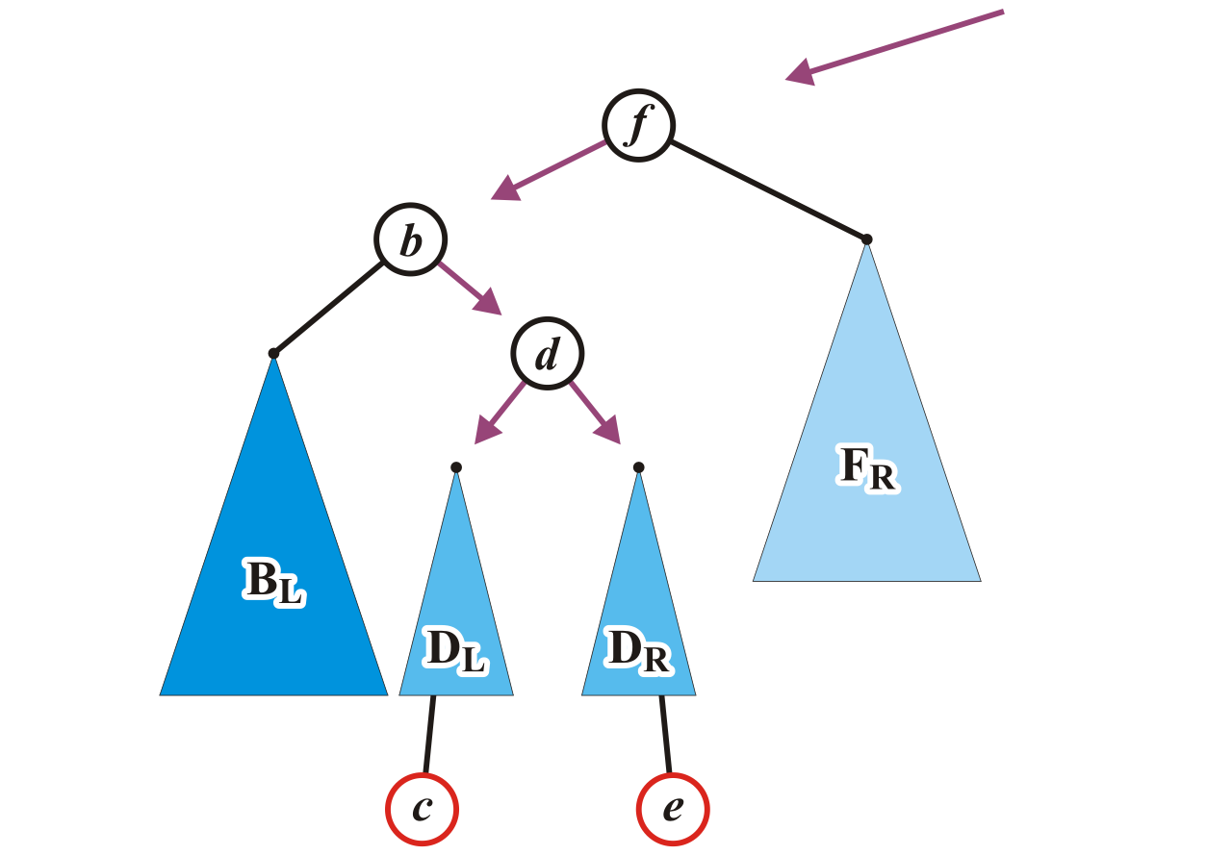
Maintaining Balance: Case 2
We will reassign the following pointers
AVL_node<Type> *b = left(), *d = b->right(), *DL = d->left(), *DR = d->right();

Slide 66
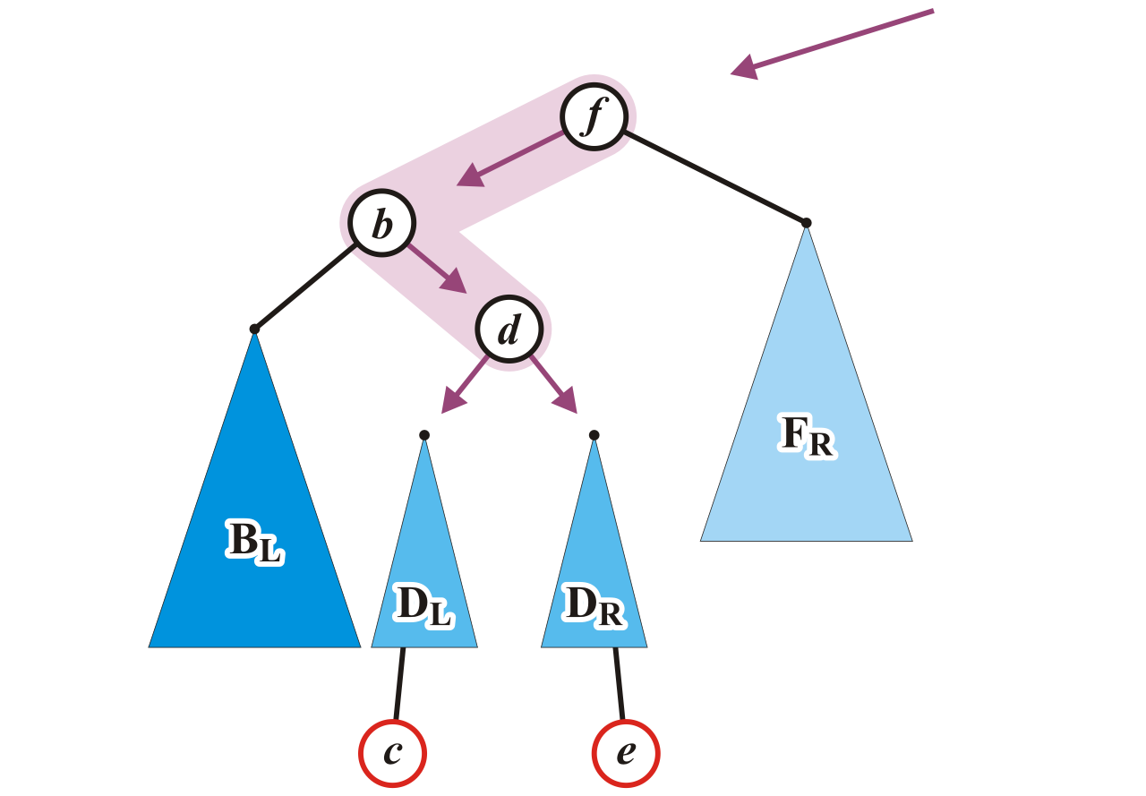
Maintaining Balance: Case 2
Specifically, we will order these three nodes as a perfect tree
Recall the second prototypical example
AVL_node<Type> *b = left(), *d = b->right(), *DL = d->left(), *DR = d->right();

Slide 67

Maintaining Balance: Case 2
To achieve this, b and f will be assigned as children of the new root d
AVL_node<Type> *b = left(), *d = b->right(), *DL = d->left(), *DR = d->right();
d->left_tree = b;
d->right_tree = this;

Slide 68

Maintaining Balance: Case 2
We also have to connect the two subtrees and original parent of f
AVL_node<Type> *b = left(), *d = b->right(), *DL = d->left(), *DR = d->right();
d->left_tree = b;
d->right_tree = this;
ptr_to_this = d;
b->right_tree = DL;
left_tree = DR;

Slide 69

Maintaining Balance: Case 2
Now the tree rooted at d is balanced

Slide 70

Maintaining Balance: Case 2
Again, the height of the root did not change

Slide 71

Maintaining Balance: Case 2
In our three sample cases with h = –1, 0, and 1, the node is now balanced and the same height as the tree before the insertion

Slide 72


Maintaining balance: symmetric cases
There are two symmetric cases to those we have examined:
Insertions into the right-right sub-tree
Insertions into either the right-left sub-tree

Slide 73
Insert (Implementation)
template <typename Type>
void AVL_node<Type>::insert( const Type & obj, AVL_node<Type> *ptr_to_this ) {
if ( empty() ) {
ptr_to_this = new AVL_node<Type>( obj );
return true;
} else if ( obj < element ) {
if ( left() -> insert() ) {
if ( left()->height() - right()->height() == 2 ) {
// determine if it is a left-left or left-right insertion
// perform the appropriate correction
} else {
tree_height = std::max( height(), left()->height() );
}
return true;
} else {
return false;
}
} else if ( obj > element ) {
// ...

Slide 74
Insertion (Implementation)
Comments:
Both balances are Θ(1)
All insertions are still Θ(ln(n))
It is possible to tighten the previous code
Aside
if you want to explicitly rotate the nodes A and B, you must also pass a reference to the parent pointer as an argument:
insert( Type obj, AVL_node<Type> * & parent )

Slide 75

Insertion
Consider this AVL tree

Slide 76

Insertion
Insert 73

Slide 77

Insertion
The node 81 is unbalanced
A left-left imbalance

Slide 78
Insertion
The node 81 is unbalanced
A left-left imbalance

Slide 79
Insertion
The node 81 is unbalanced
A left-left imbalance
Promote the intermediate node to the imbalanced node

Slide 80
Insertion
The node 81 is unbalanced
A left-left imbalance
Promote the intermediate node to the imbalanced node
75 is that node

Slide 81

Insertion
The node 81 is unbalanced
A left-left imbalance
Promote the intermediate node to the imbalanced node
75 is that node

Slide 82

Insertion
The tree is AVL balanced

Slide 83

Insertion
Insert 77

Slide 84

Insertion
The node 87 is unbalanced
A left-right imbalance

Slide 85
Insertion
The node 87 is unbalanced
A left-right imbalance

Slide 86
Insertion
The node 87 is unbalanced
A left-right imbalance
Promote the intermediate node to the imbalanced node

Slide 87
Insertion
The node 87 is unbalanced
A left-right imbalance
Promote the intermediate node to the imbalanced node
81 is that value

Slide 88

Insertion
The node 87 is unbalanced
A left-right imbalance
Promote the intermediate node to the imbalanced node
81 is that value

Slide 89

Insertion
The tree is balanced

Slide 90

Insertion
Insert 76

Slide 91

Insertion
The node 78 is unbalanced
A left-left imbalance

Slide 92

Insertion
The node 78 is unbalanced
Promote 77

Slide 93

Insertion
Again, balanced

Slide 94

Insertion
Insert 80

Slide 95

Insertion
The node 69 is unbalanced
A right-left imbalance
Promote the intermediate node to the imbalanced node

Slide 96

Insertion
The node 69 is unbalanced
A right-left imbalance
Promote the intermediate node to the unbalanced node
75 is that value

Slide 97

Insertion
Again, balanced

Slide 98

Insertion
Insert 74

Slide 99

Insertion
The node 72 is unbalanced
A right-right imbalance
Promote the intermediate node to the imbalanced node
75 is that value

Slide 100

Insertion
The node 72 is unbalanced
A right-right imbalance
Promote the intermediate node to the imbalanced node

Slide 101

Insertion
Again, balanced

Slide 102

Insertion
Insert 64?

Slide 103
Insertion
This causes no imbalance

Slide 104

Insertion
Insert 55

Slide 105

Insertion
The node 69 is imbalanced
A left-left imbalance
Promote the intermediate node to the imbalanced node

Slide 106

Insertion
The node 69 is imbalanced
A left-left imbalance
Promote the intermediate node to the imbalanced node
63 is that value

Slide 107

Insertion
The tree is now balanced

Slide 108

Insertion
Insert 70?

Slide 109

Insertion
The root node is now imbalanced
A right-left imbalance
Promote the intermediate node to the root
75 is that value

Slide 110

Insertion
The root node is imbalanced
A right-left imbalance
Promote the intermediate node to the root
63 is that node

Slide 111

Insertion
The result is AVL balanced

Slide 112
Erase
Removing a leaf node from an AVL tree may cause more than one AVL imbalance
Like insert, erase must check if it caused an imbalance
Unfortunately, it may cause O(h) imbalances that must be corrected
Insertions will only cause one imbalance that must be fixed
What if we want to remove an internal node?
- The same way as we taught in the previous BST lecture.

Slide 113


Maintaining Balance: Case 3 (≈Case 1)
This case will only happen after erasing a leaf node, but not after inserting a node. Do the same as in Case 1.

Slide 114

Erase
Consider the following AVL tree

Slide 115

Erase
Suppose we erase the front node: 1

Slide 116

Erase
While its previous parent, 2, is not unbalanced, its grandparent 3 is
The imbalance is in the right-right subtree (Case 1)

Slide 117

Erase
We can correct this with a simple balance

Slide 118

Erase
The node of that subtree, 5, is now balanced

Slide 119

Erase
Recursing to the root, however, 8 is also unbalanced
This is a right-left imbalance (Case 2)

Slide 120

Erase
Promoting 11 to the root corrects the imbalance

Slide 121

Erase
At this point, the node 11 is balanced

Slide 122

Erase
Still, the root node is unbalanced
This is a right-right imbalance (Case 1)

Slide 123

Erase
Again, a simple balance fixes the imbalance

Slide 124

Erase
The resulting tree is now AVL balanced
Note, few erases will require one balance, even fewer will require more than one

Slide 125
Time complexity
Insertion
May require one correction to maintain balance
Each correction require Θ(1) time
Erasion
May require O(h) corrections to maintain balance
Each correction require Θ(1) time
Depth h is Θ( ln(n) )
So the time complexity is O( ln(n) )

Slide 126
AVL Trees as Arrays?
We previously saw that:
Complete tree can be stored using an array using Θ(n) memory
An arbitrary tree of n nodes requires O(2^{n}) memory
Is it possible to store an AVL tree as an array and not require exponentially more memory?

Slide 127
AVL Trees as Arrays?
Recall that in the worst case, an AVL tree of n nodes has a height at most
log_{φ}(n) – 1.3277
Such a tree requires an array of size
2^{logφ(n) – 1.3277 + 1} – 1
We can rewrite this as
2^{–0.3277} n^{logφ(2)} ≈ 0.7968 n^{1.44}
Thus, we would require O(n^{1.44}) memory
Notes:
Recall that a^{log[b](c)} = c^{log[b](a)} for all values of a, b, and c.
Here, log[b](c) is the logarithm base ‘b’ of c.

Slide 128

AVL Trees as Arrays?
While the polynomial behaviour of n^{1.44} is not as bad as exponential behaviour, it is still reasonably sub-optimal when compared to the linear growth associated with link- allocated trees
Here we see n and n^{1.44} on [0, 1000]

Slide 129
Summary
AVL trees
Balance: difference in subtree heights is 0 or 1
Insertion and erasion may require the tree to be rebalanced by tree rotations

Slide 130
Usage Notes
These slides are made publicly available on the web for anyone to use
If you choose to use them, or a part thereof, for a course at another institution, I ask only three things:
that you inform me that you are using the slides,
that you acknowledge my work, and
that you alert me of any mistakes which I made or changes which you make, and allow me the option of incorporating such changes (with an acknowledgment) in my set of slides
Sincerely,
Douglas Wilhelm Harder, MMath
dwharder@alumni.uwaterloo.ca

